Slide 1
Refrigerators and Refrigerants

Slide 2
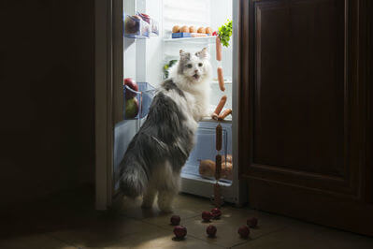
By the end of this lesson you should be able to:
Explain how heat transfer and pressure changes are used to move heat in refrigerators.
Describe the changes in state, temperature and pressure refrigerants experience during the refrigeration cycle.
Discuss what makes a substance a suitable refrigerant.

Slide 3
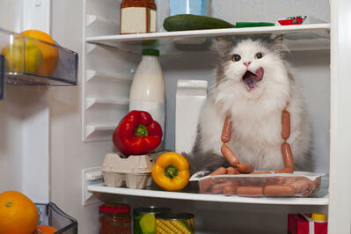
What goes on inside that fridge of yours?
In this lesson, we're going to learn how refrigerators work using the principles of heat transfer, state changes, and pressure changes.
Before we get started, we need to remind ourselves of some basic concepts about heat transfer, temperature, and pressure.

Slide 4
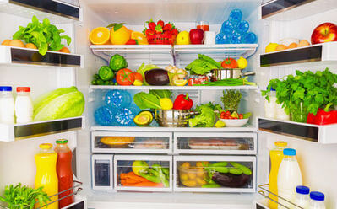
Have you ever wondered how your fridge stays cold?
We know that heat always moves from a warmer substance to a cooler substance. Therefore, to decrease the temperature of the air inside the fridge, the heat must be transferred to a substance that is colder than the fridge. This substance is called the refrigerant.

Slide 5
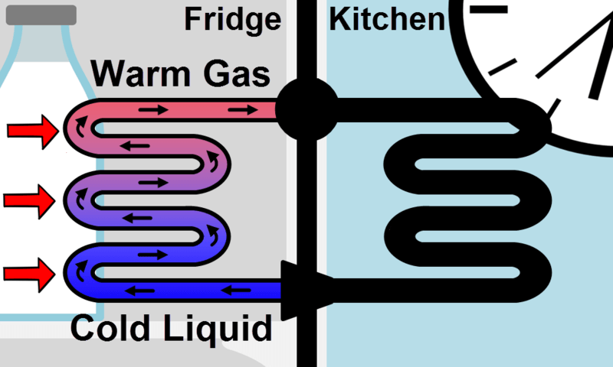
The refrigerant starts off as a cold liquid that flows through pipes in your fridge.
The liquid refrigerant is colder than the air and food inside your fridge, so it absorbs heat from within the fridge.
This cools the contents of the fridge and heats up the refrigerant. As a result, the liquid refrigerant vaporises into a gas.

Slide 6
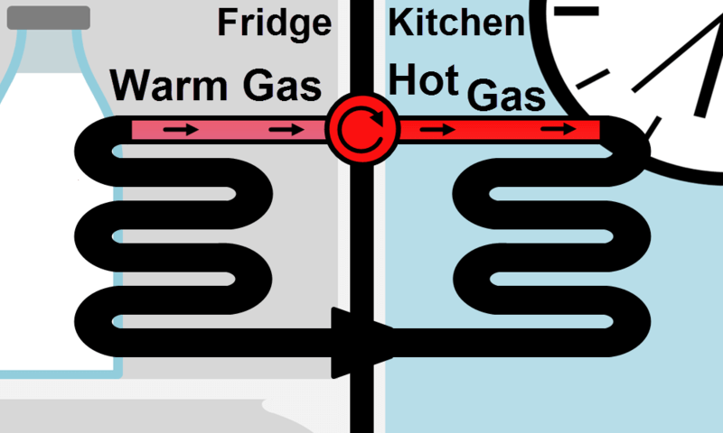
Now the food in your fridge is cool, but the refrigerant needs to get rid of the heat it absorbed.
After absorbing heat from the fridge, the refrigerant goes through a compressor. This increases the pressure and temperature of the gas, so it is now very hot.

Slide 7
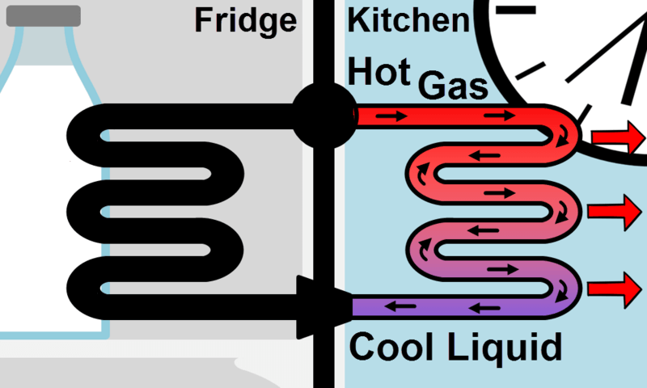
After being compressed, this hot gas is run through piping on the outside of the fridge.
Because the gas is so hot, it quickly releases heat into the kitchen.
This cools the refrigerant down, causing it to condense into a liquid.

Slide 8
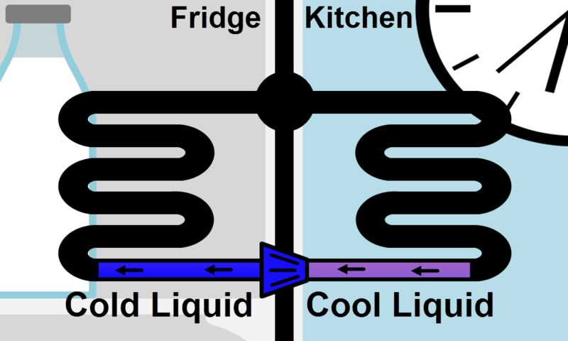
The final step is running the condensed refrigerant through an expanding device.
This decreases the pressure and temperature of the liquid refrigerant.
Now the refrigerant is ready to start the cycle over again, as it is once again cold enough to chill the inside of your fridge!

Slide 9
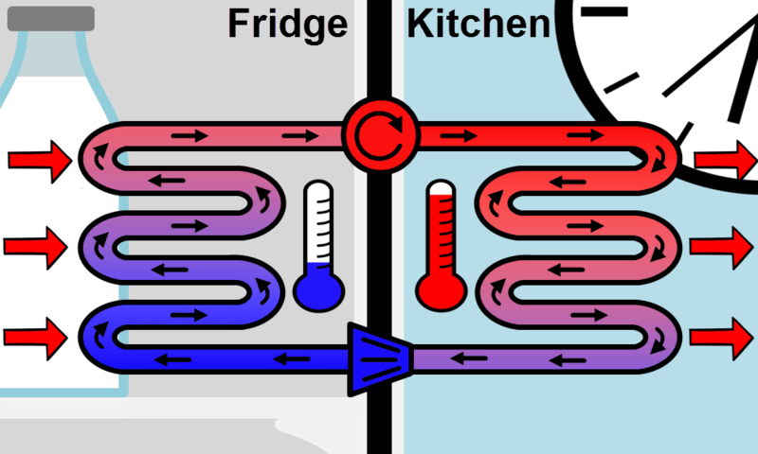
Incorporating expansion and compression into the refrigeration cycle ensures the refrigerant is moving heat in the correct direction.
By reducing the refrigerant's pressure before it enters the fridge, we ensure it is as cold as can be and will absorb lots of heat.
Similarly, by increasing the refrigerant's pressure when it exits the fridge, we ensure it is as hot as can be and will expel all of the heat it picked up into the kitchen.

Slide 10
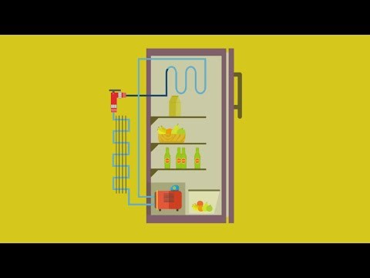

Slide 11
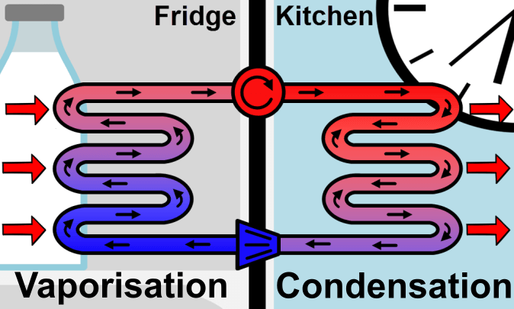
Refrigeration Summary:
The cooled liquid refrigerant absorbs heat from inside the fridge, causing it to vaporise.
The hot, gaseous refrigerant then releases heat outside the fridge, causing it to condense back into a liquid.
The refrigerant's pressure is manipulated using compressors and expanding devices to make sure heat is always moved in the correct direction.

Slide 12
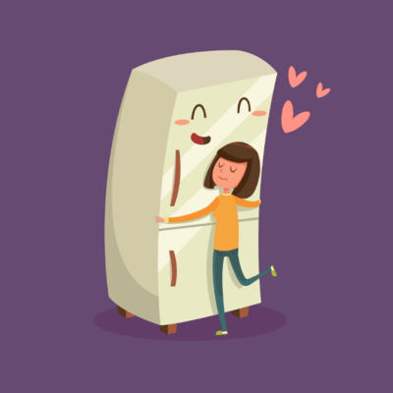
What exactly is a refrigerant?
A refrigerant is the substance that is circulated in a heating or refrigeration system.
There are many different substances that are used as refrigerants, but some substances are better refrigerants than others.

Slide 13
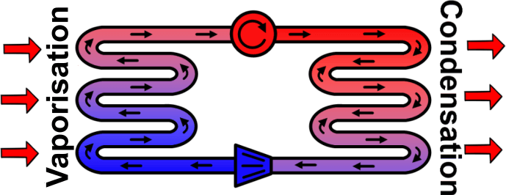
What makes a good refrigerant?
For a refrigerant to effectively cool a fridge, it should boil from a liquid to a gas as it moves through the pipes inside of the fridge.
It should also condense from a gas to a liquid as it moves through the pipes on the outside of the fridge. This is possible because the boiling point of the refrigerant changes when the pressure changes.

Slide 14

How does vaporising and condensing make a substance a more effective refrigerant?
To understand why transitioning between liquid and gaseous states makes a refrigerant better, let's look at what happens to the particles in a substance when it changes state.

Slide 15
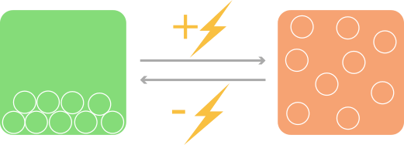
A substance's particles gain and lose energy during state changes.
When a liquid is heated, it gains energy. This allows it to overcome the attractions holding the particles together. The particles spread out and the liquid vaporises into a gas.
The reverse happens when a gas is cooled. The particles lose energy and can no longer overcome the attractions between them. They move closer together and the gas condenses into a liquid.

Slide 16
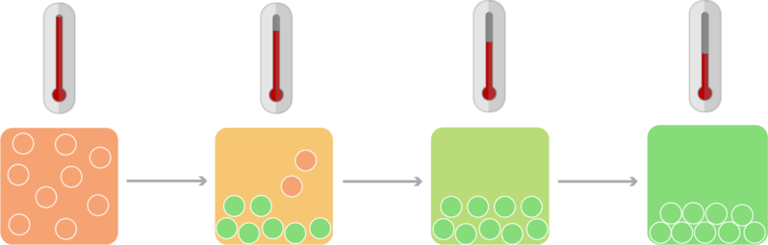
Overcoming the attractions between particles consumes a lot of energy: much more energy than it takes to heat the substance a few degrees.
When a liquid vaporises into a gas, its particles absorb a huge amount of energy!
When the gas condenses back into a liquid, the particles release a huge amount of energy.
This energy is referred to as heat.

Slide 17
Using a refrigerant that vaporises and condenses in the refrigeration cycle means the fridge is more effectively cooled.
The refrigerant starts as a cold liquid moving through piping in the fridge. It absorbs heat from the warmer fridge air, increasing its temperature. Once the refrigerant gets warm enough, it vaporises. To complete this vaporisation it absorbs even more heat energy!
This means the refrigerant absorbs more heat if it vaporises than if it does not. It also releases this heat when it condenses in the piping on the outside of the fridge.

